Slide 1


OFFICE RAGE
Alexandre SACHS
Raphaël Guy
Kellian CIPIERRE
Charles Descoust

Slide 2

3D Game Action Adventure Beat Them All

Slide 3
Charles Descoust
Level Design

Slide 4
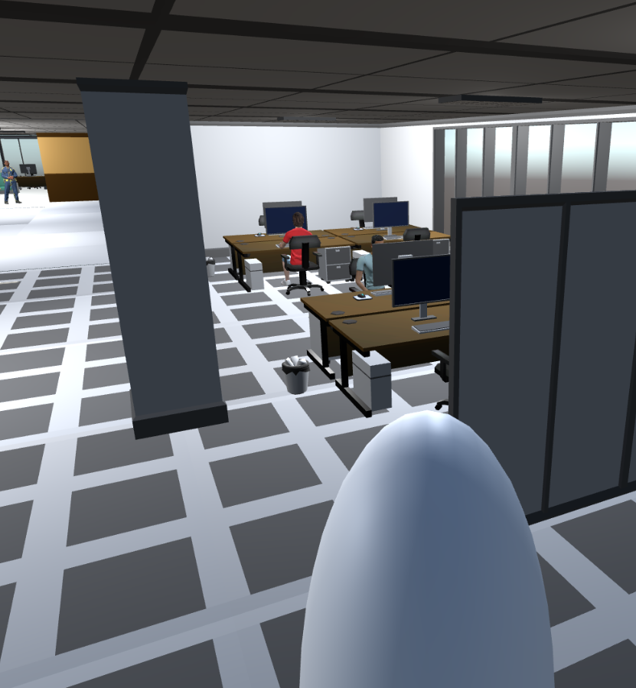
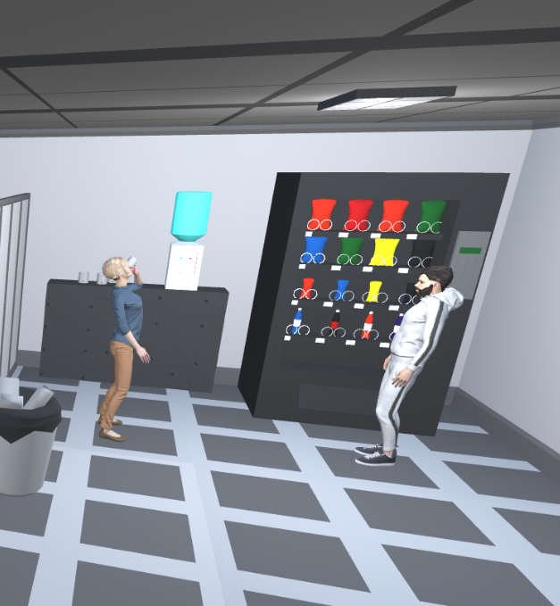

Slide 5
Kellian Cipierre
Enemies

Slide 6
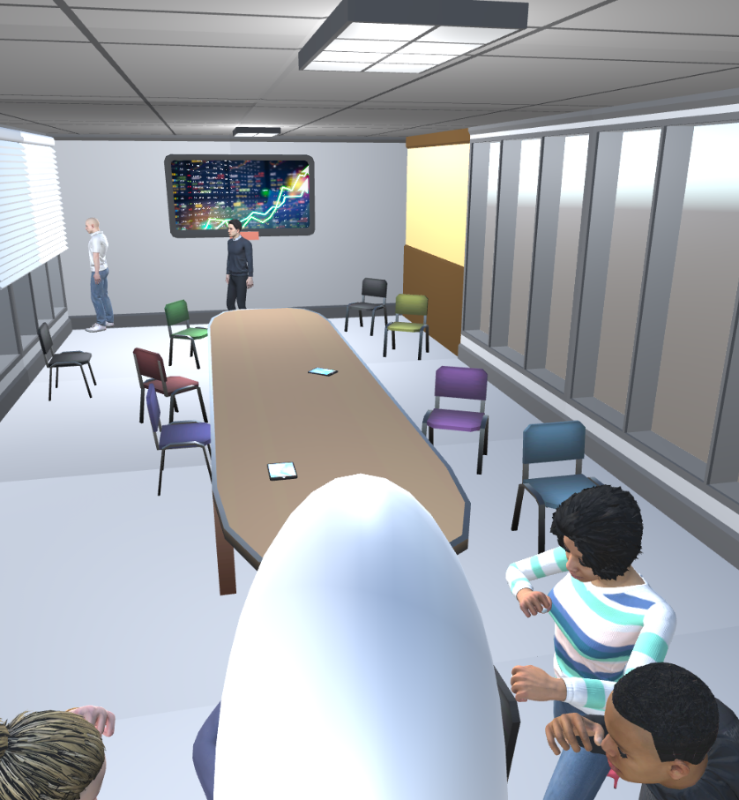
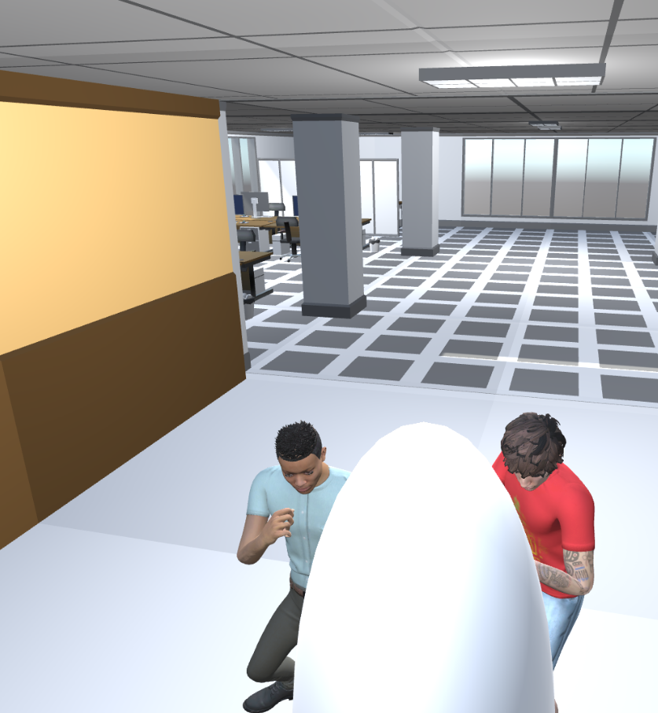

Slide 7
Raphaël Guy
Player

Slide 8
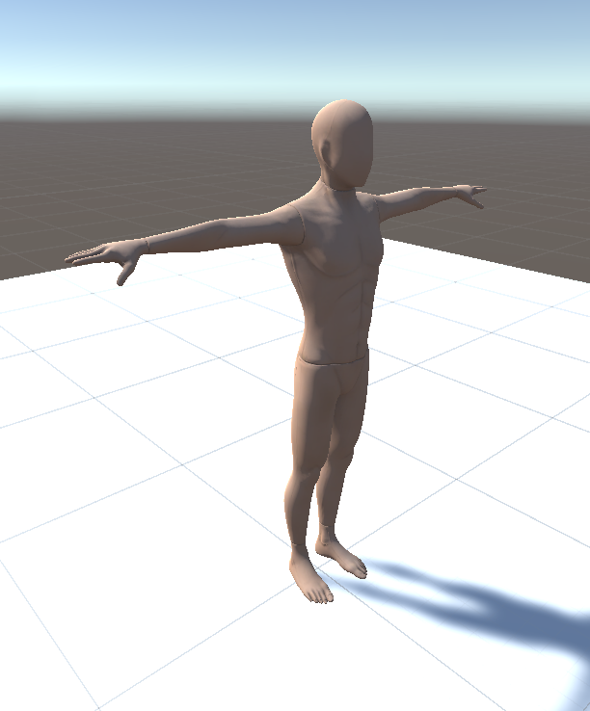

Slide 9
Alexandre Sachs
Menus

Slide 10
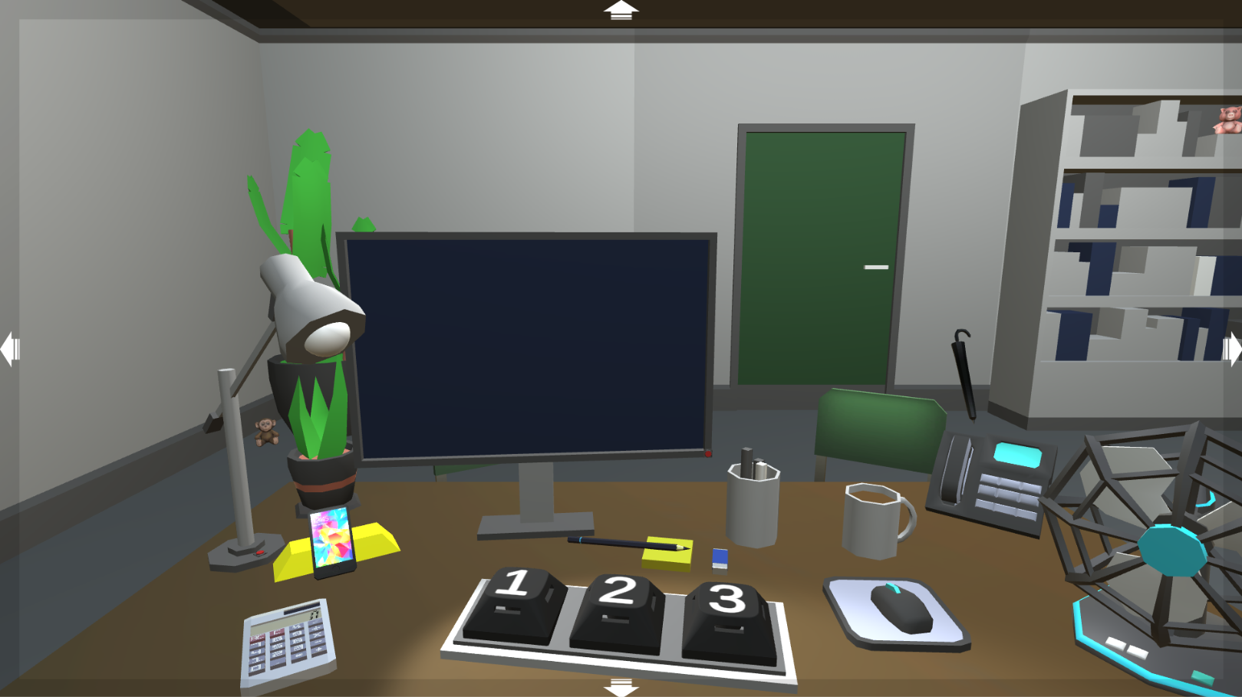

Slide 11
OFFICE RAGE
Alexandre SACHS
Raphaël Guy
Kellian CIPIERRE
Charles Descoust

